Slide 1







Compute Continuum
Managing Resources between
Cloud, Edge, and Endpoint
A Lecture and Demo by Matthijs Jansen
m.s.jansen@vu.nl
http://atlarge.science/mjansen
Continuum
Open-source Code

Slide 2
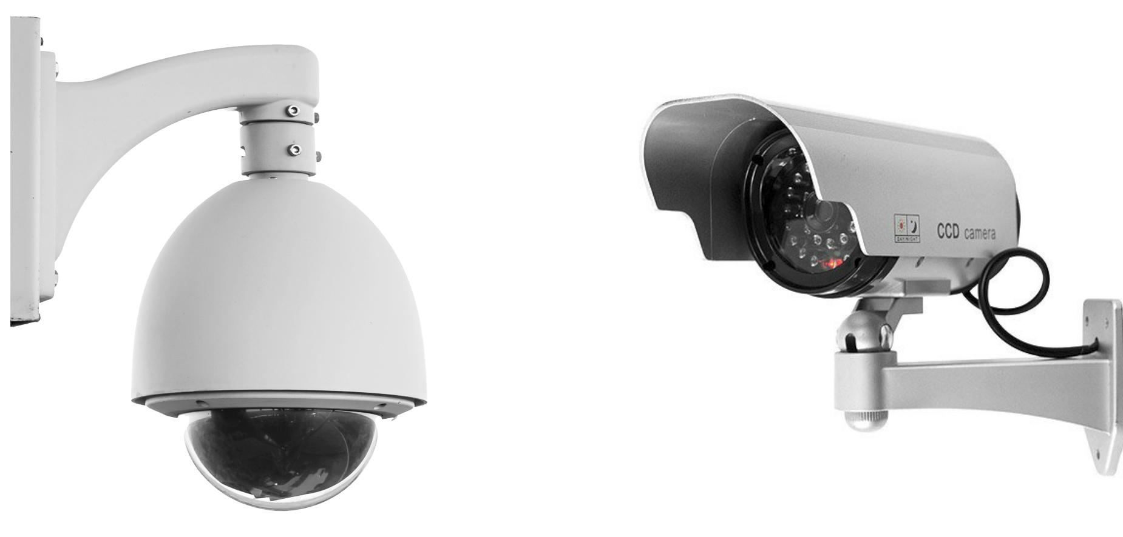

Compute and Data Offloading
Requirement: Process live video
Problem: Little resources for native processing
Solution: Offload data to other devices

Slide 3

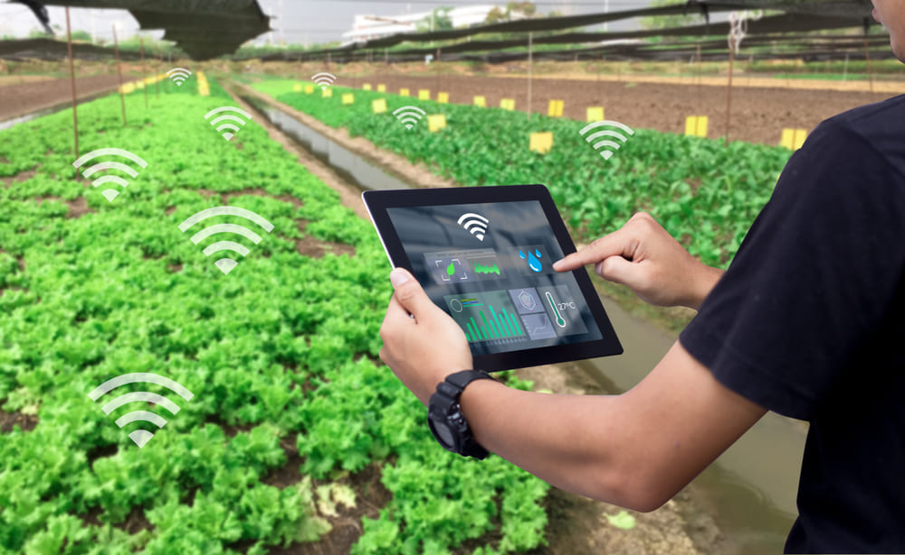
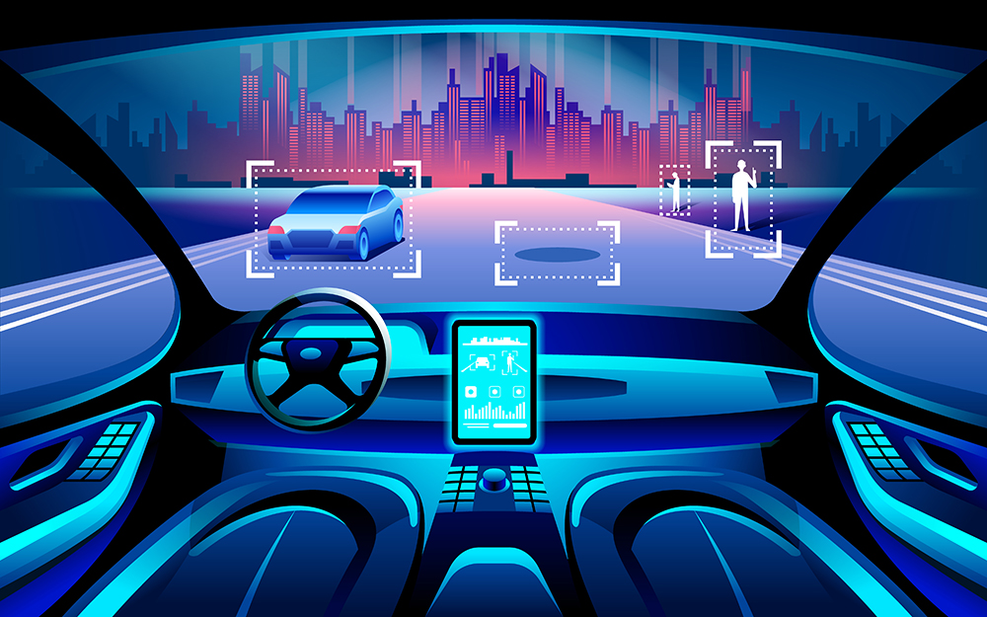

Offloading Scenarios
There are many offloading scenarios
Many questions to answer:
Where to offload from/to?
Available resources?
Application requirements?

Slide 4
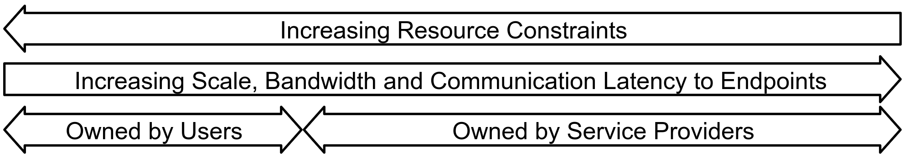
Compute Continuum in 3 Layers
Generates data through users and sensors
Native processing requires no offloading
No need to share resources
Limited resources and energy
Mobile
Endpoint

Slide 5
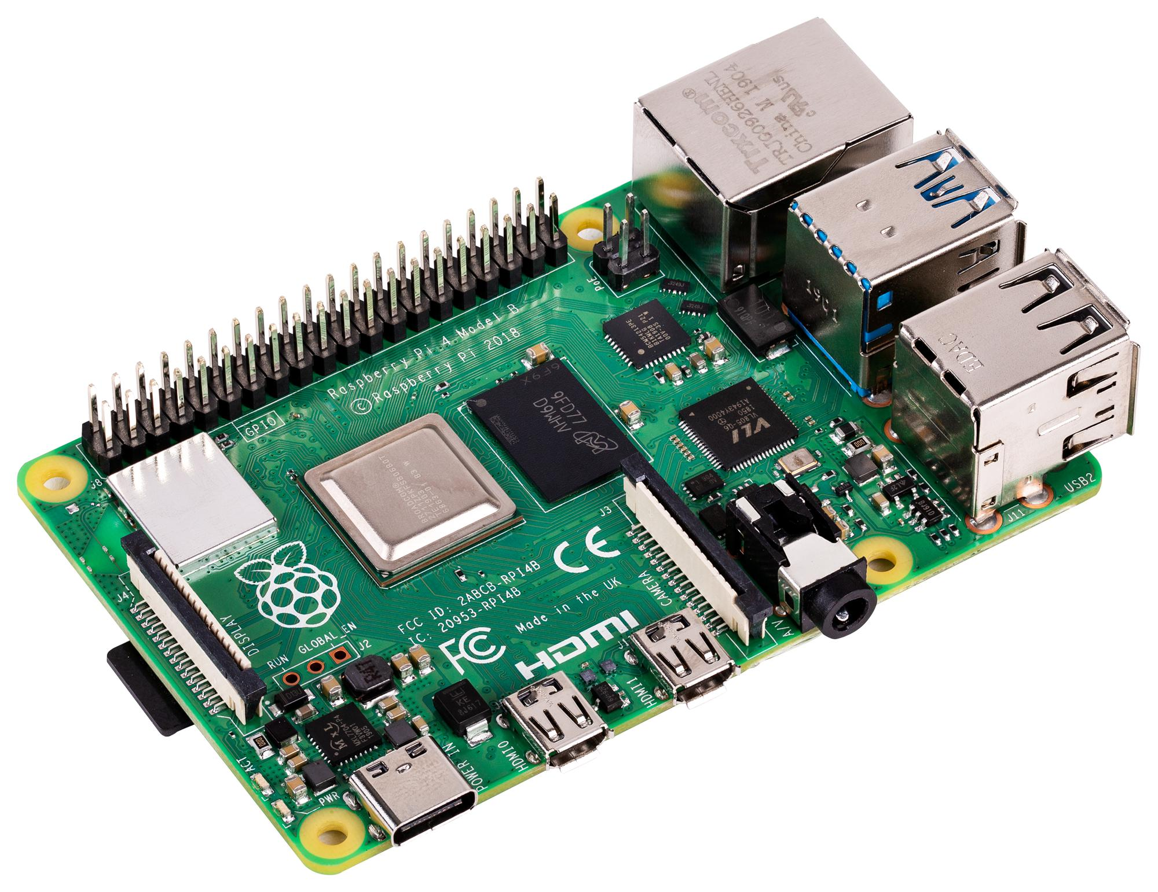
Compute Continuum in 3 Layers
More resources than endpoints
Low latency to endpoint and cloud
Limited reliability
Offload target for endpoint users AND cloud services
Edge

Slide 6

Compute Continuum in 3 Layers
High latency to endpoints
Owned by cloud provider (privacy?)
Near-infinite resources
Variety of services
Cloud

Slide 7
Compute Continuum in 3 Layers
Endpoint
Edge
Cloud

Slide 8
Offloading Choices: Big Impact
Time to process 1 image
Native: 1s
Edge: .5s
Cloud: .2s
WiFi: .1s
Wired: .05s
Wired: .01s
Endpoint
Edge
Cloud

Slide 9
Offloading Choices: Big Impact
Time to process 2 images in parallel
Native: 1s
Edge: .8s
Cloud: .3s
WiFi: .1s
Wired: .01s
Wired: .01s
Endpoint
Edge
Cloud

Slide 10
Offloading Choices: Big Impact
Time to process 2 images in parallel
How do I find a deployment in the
Compute Continuum that works
best for my requirements?
Native: 1s
Edge: .8s
Cloud: .3s
WiFi: .1s
Wired: .01s
Wired: .01s
Endpoint
Edge
Cloud

Slide 11
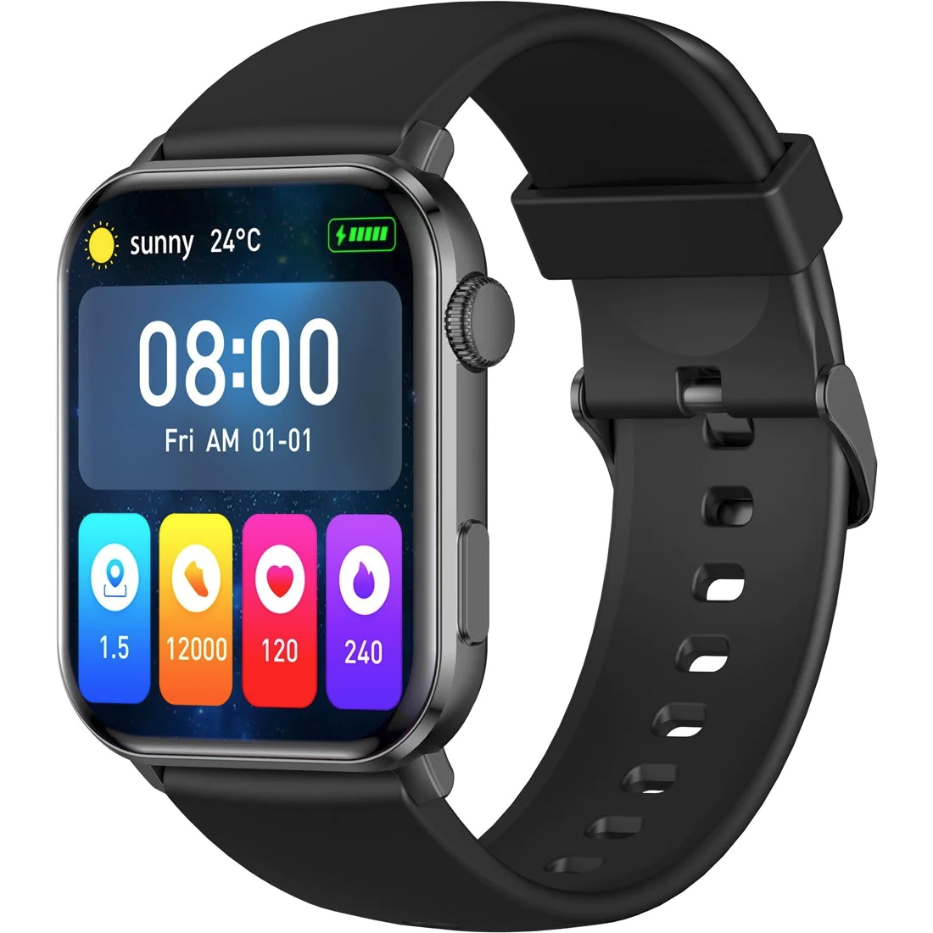
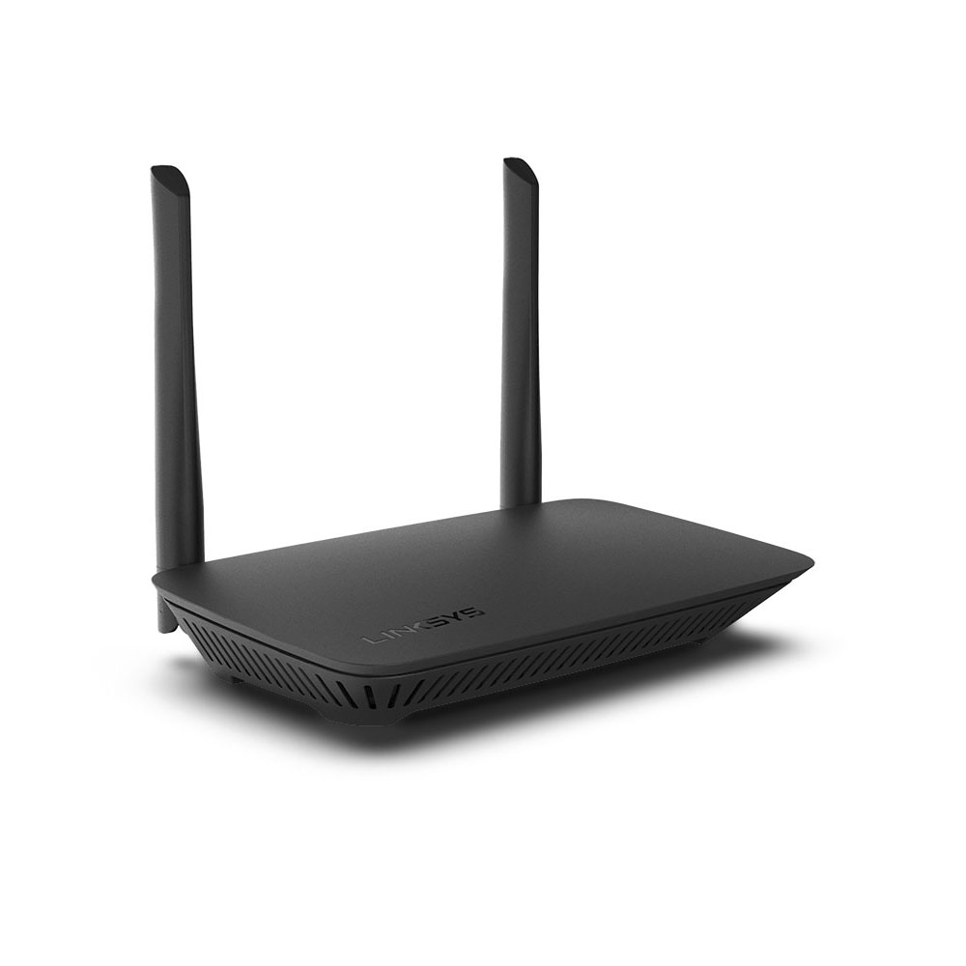
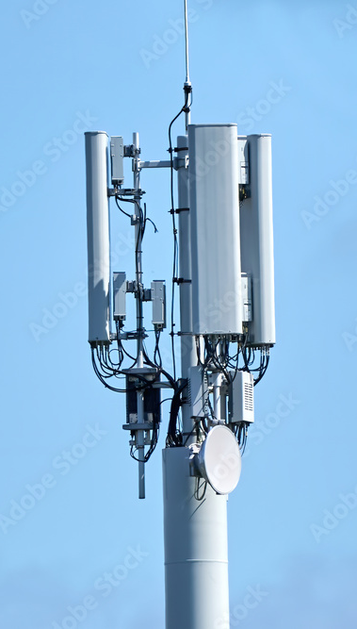
How Do I Use the Compute Continuum?
Software dev.
How to test software across devices?
Service provider
How to offer services across all devices?

Slide 12
Challenges in the Compute Continuum
Q1: Where to deploy?
Need access to infrastructure
→X86 vs ARM
→Wired vs Wireless
→Expensive!
Q2: What software to deploy?
Layers have different requirements
→Tensorflow vs Tensorflow Lite
→Kubernetes vs KubeEdge
→Takes a lot of time!
Notes:
challenge 1: each continuum layer has different requirements, hence different infrastructure that does different things
challenge 2: because of the different requirements and infrastructure per layer, we need different software. Software between layers is incompatible

Slide 13
Challenges in the Compute Continuum
Q1: Where to deploy?
Need access to infrastructure
→X86 vs ARM
→Wired vs Wireless
→Expensive!
Q2: What software to deploy?
Layers have different requirements
→Tensorflow vs Tensorflow Lite
→Kubernetes vs KubeEdge
→Takes a lot of time!
Conclusion:
Problems are difficult to solve
→What do we do?
Notes:
challenge 1: each continuum layer has different requirements, hence different infrastructure that does different things
challenge 2: because of the different requirements and infrastructure per layer, we need different software. Software between layers is incompatible

Slide 14
Continuum
Automated infrastructure and software exploration for the compute continuum
https://github.com/atlarge-research/continuum
Notes:
The goal: Allow for rapid exploration of compute continuum deployments

Slide 15
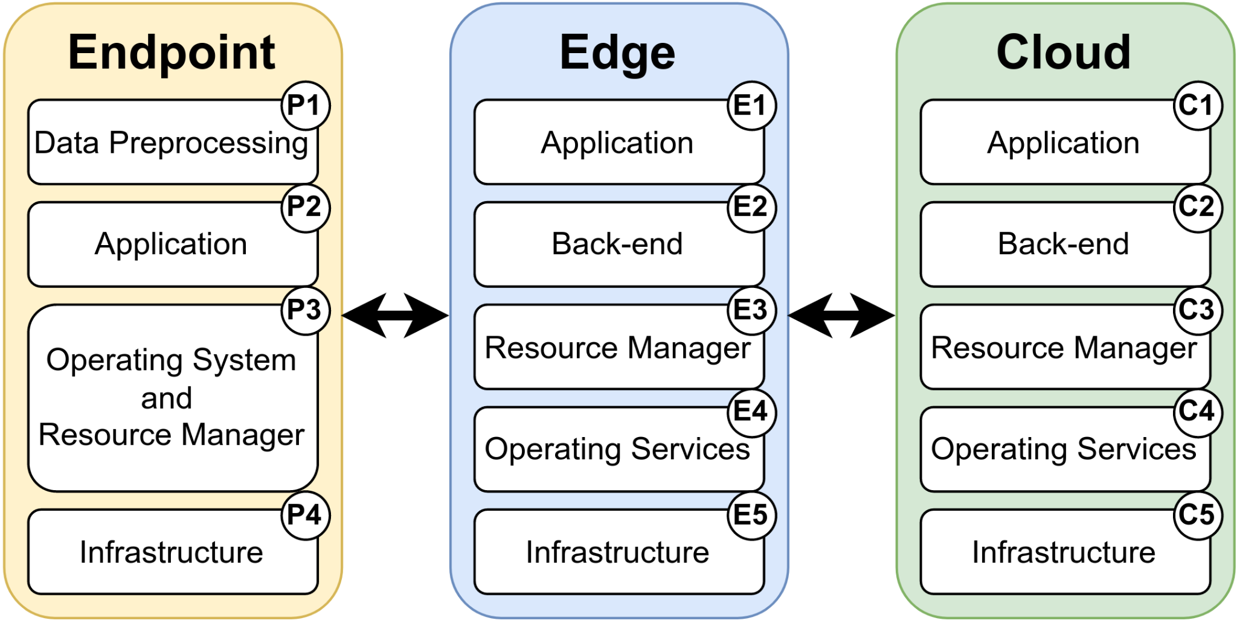
Reference Architecture
Compute Continuum Abstraction layers
Changing any layer impacts offloading
The SPEC-RG Reference Architecture for the Compute Continuum, Jansen et al, CCGRID’23

Slide 16
Reference Architecture Pillars
Workload
Software
Infrastructure

Slide 17
Reference Architecture Pillars
Workload
#Tenants
Software
Infrastructure

Slide 18
Reference Architecture Pillars
Goal
Build a deployment framework
where users can change any layer
Workload
#Tenants
Software
Infrastructure

Slide 19
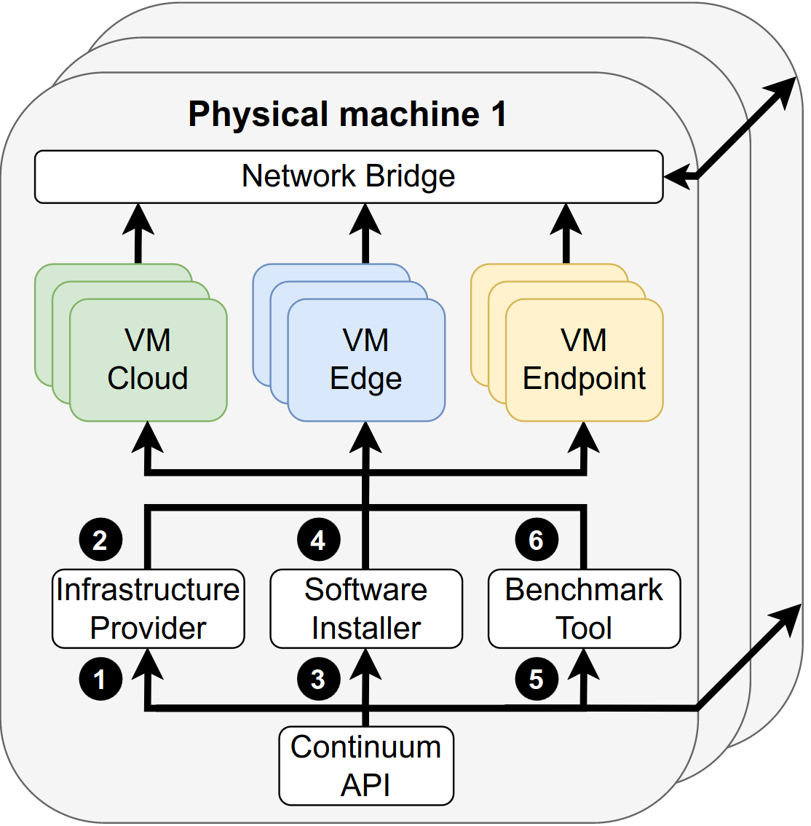
The Continuum Framework
Execution phases:
Provision infrastructure
Install software
Benchmark applications

Slide 20
The Continuum Framework
Design principles
Accurate
→ Deploy on hardware
Flexible
→ Emulate hardware and
networks you have
Automated
→ Script deployments
Extendable
→ Components as modules

Slide 21
Today’s Use Case
Video camera processing with image classification
Generate X frames per second
Analyze each frame with ML
ML can’t run on endpoint
So, offload to cloud
Using cloud-native technologies
Notes:
Why are containers and resource managers like Kubernetes important
They are used by everyone

Slide 22
Step 1: Infrastructure Provisioning
config-file.cfg
VM1
CLOUD
VM2
CLOUD
VM 3
ENDPOINT
[infrastructure]
provider = Local / QEMU
cloud vms = 2
cloud cores = 4
cloud memory = 16
endpoint vms = 1
endpoint cores = 1
endpoint memory = 0.5
Physical machine
Network Emulation
network = 4G
Notes:
Why are containers and resource managers like Kubernetes important
They are used by everyone

Slide 23
Step 1: Infrastructure Provisioning
VM1
CLOUD
VM2
CLOUD
VM3
CLOUD
VM4
CLOUD
VM5
CLOUD
VM6
CLOUD
VM7
CLOUD
How do we deploy applications on VMs?
Think cloud-scale: 1000s of VMs and 1000s of users
Notes:
Why are containers and resource managers like Kubernetes important
They are used by everyone

Slide 24
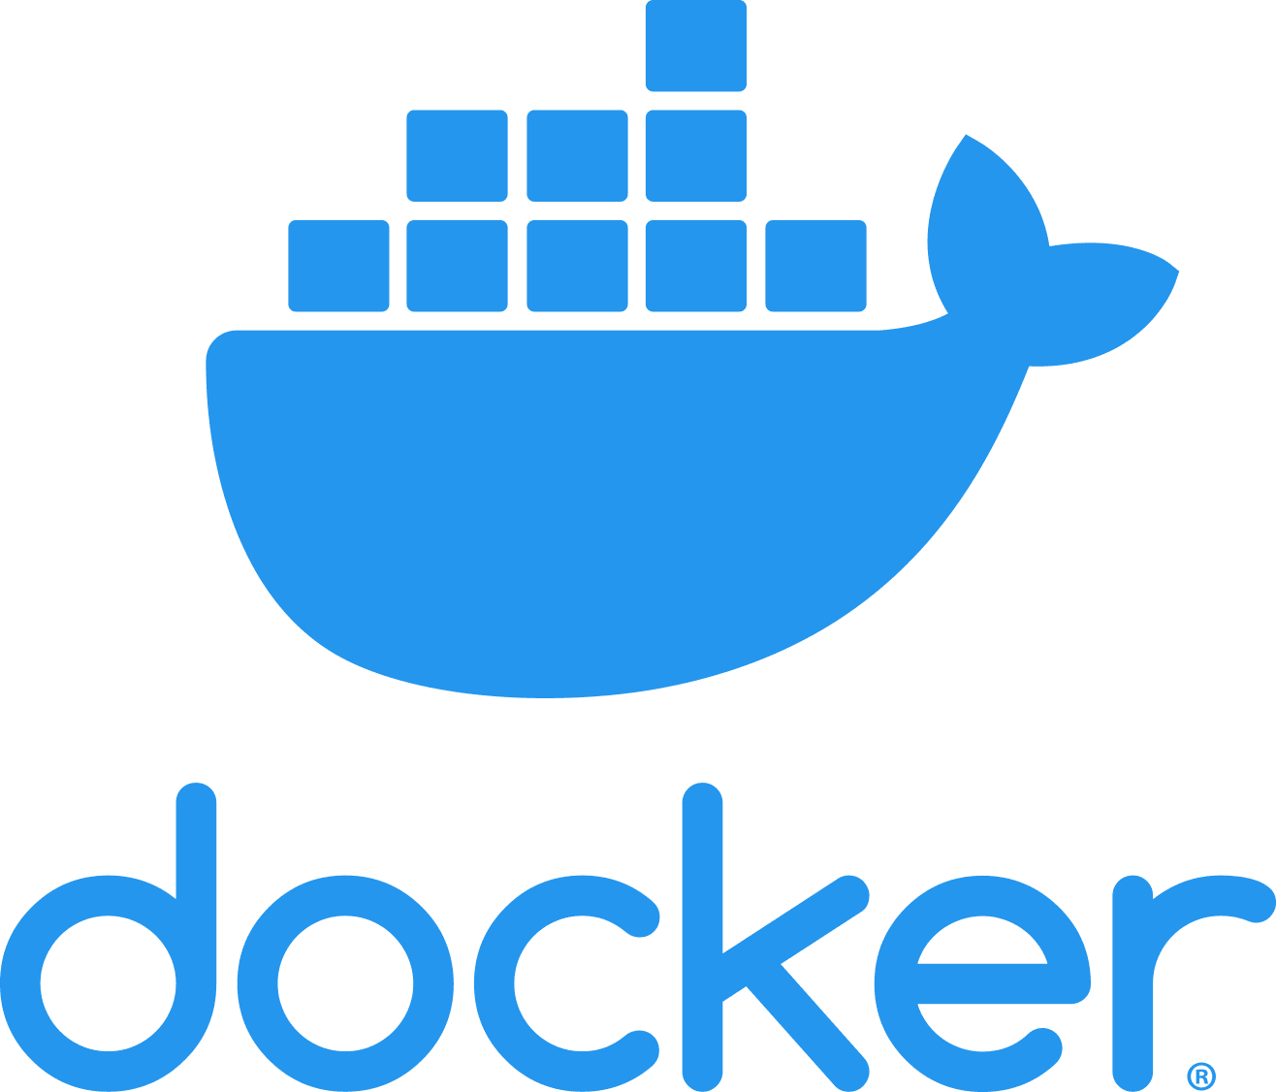
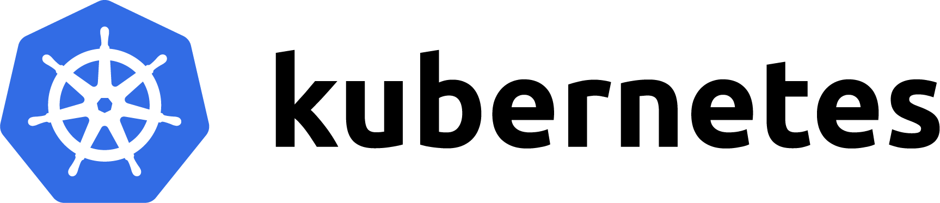
Containerization
Container benefits:
Virtualization with little overhead
Portable
Predictable execution
Machine 1 .. N
In data centers:
Many containers across many machines
Resource managers reduce complexity
Notes:
Many applications nowadays are containerized, wrapped in containers
Containers are virtual environments that wrap your software and dependencies nicely together
This results in portability, fast development, predictable execution
So, containers make application deployment easier, but we still face many challenges for deployment in data centers because of its distributed nature, so we use data centers
Mention Kubernetes and docker example in picture

Slide 25
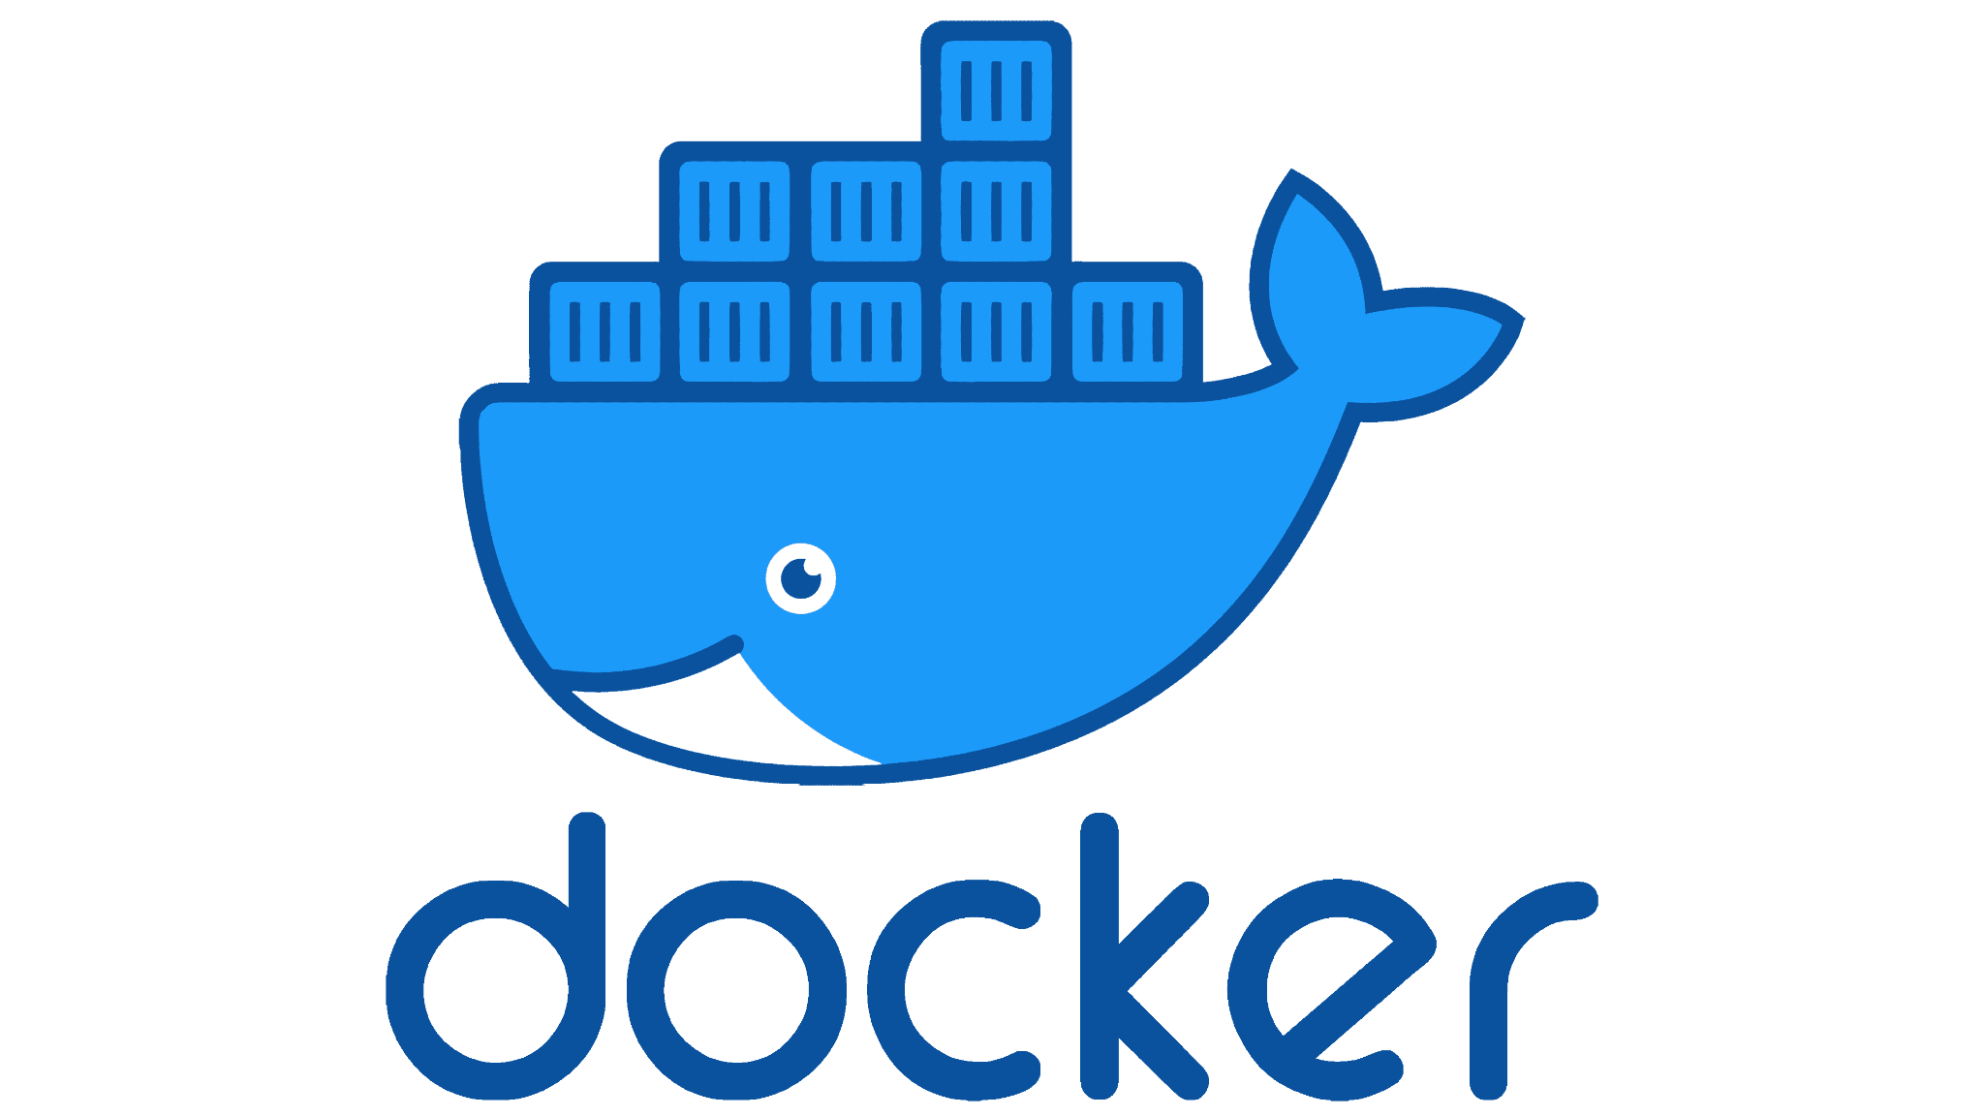
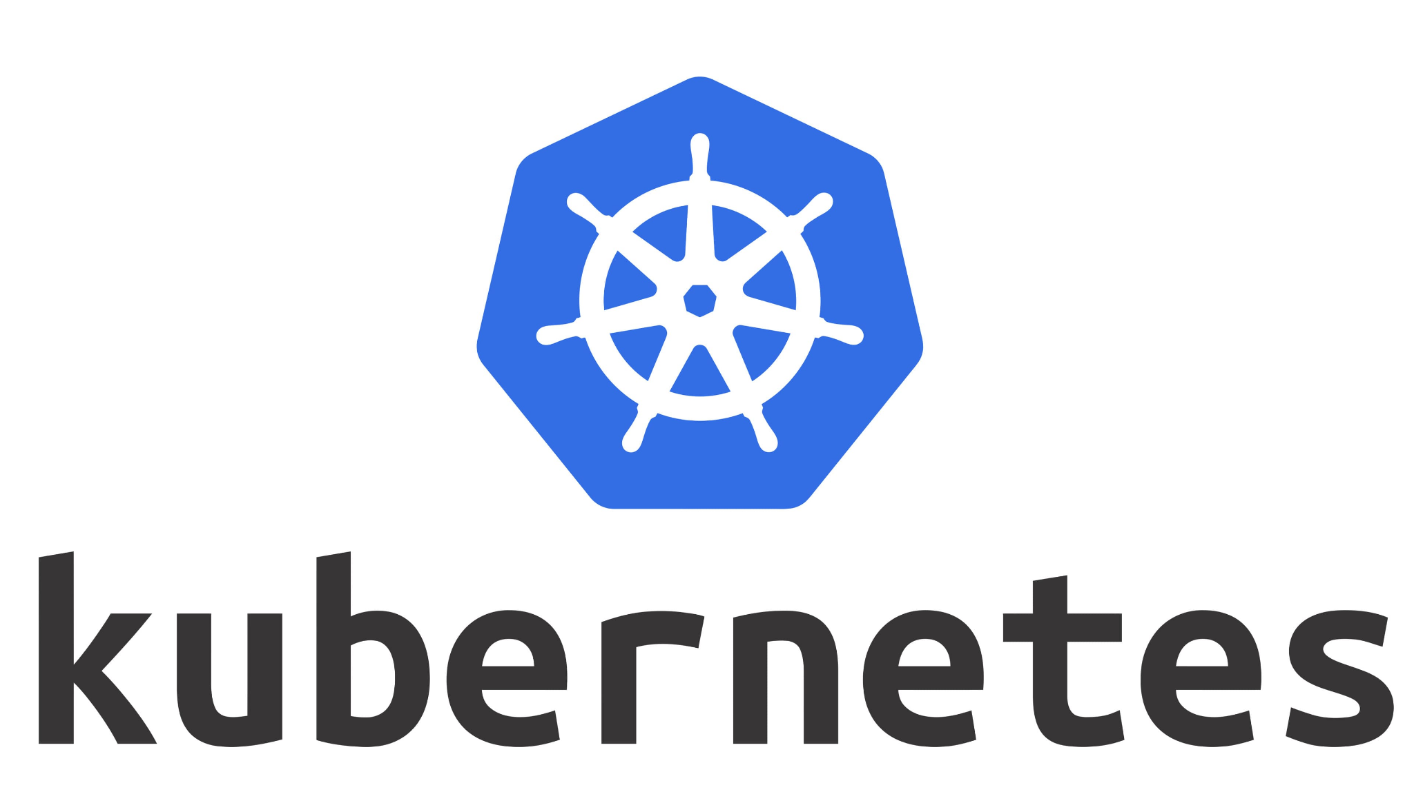
Step 2: Software Installation
resource manager = kubernetes
config-file.cfg
Continuum Framework
Virtual Machine 1
Kubernetes
Control Plane
Virtual Machine 2
Kubernetes
Cloud Worker
Virtual Machine 3
Docker
Endpoint / User
Notes:
Why are containers and resource managers like Kubernetes important
They are used by everyone

Slide 26
Step 2+3: Software and Benchmark
Software: Kubernetes + Docker
User registers app to K8s
Kubernetes deploys server component on cloud worker
User deploys generator component on endpoint
Generator sends data to cloud
Cloud processes data, sends result back to endpoint
Continuum Framework
Virtual Machine 1
Kubernetes
Control Plane
2
Virtual Machine 2
Kubernetes
Cloud Worker
4
5
1
Virtual Machine 3
Docker
Endpoint / User
3
Notes:
What is this difficulty? Difficulty of configuring Kubernetes. Large design space
I will explain the picture later in-depth

Slide 27
Step 3: Benchmark Execution
config-file.cfg
application = image class.
app cloud cpu = 1.0
app cloud memory = 3.0
app endpoint cpu = 1.0
app endpoint memory = 1.0
Continuum Framework
Virtual Machine 1
Kubernetes
Control Plane
2
Virtual Machine 2
Kubernetes
Cloud Worker
4
5
1
Virtual Machine 3
Docker
Endpoint / User
3
Notes:
Why are containers and resource managers like Kubernetes important
They are used by everyone

Slide 28
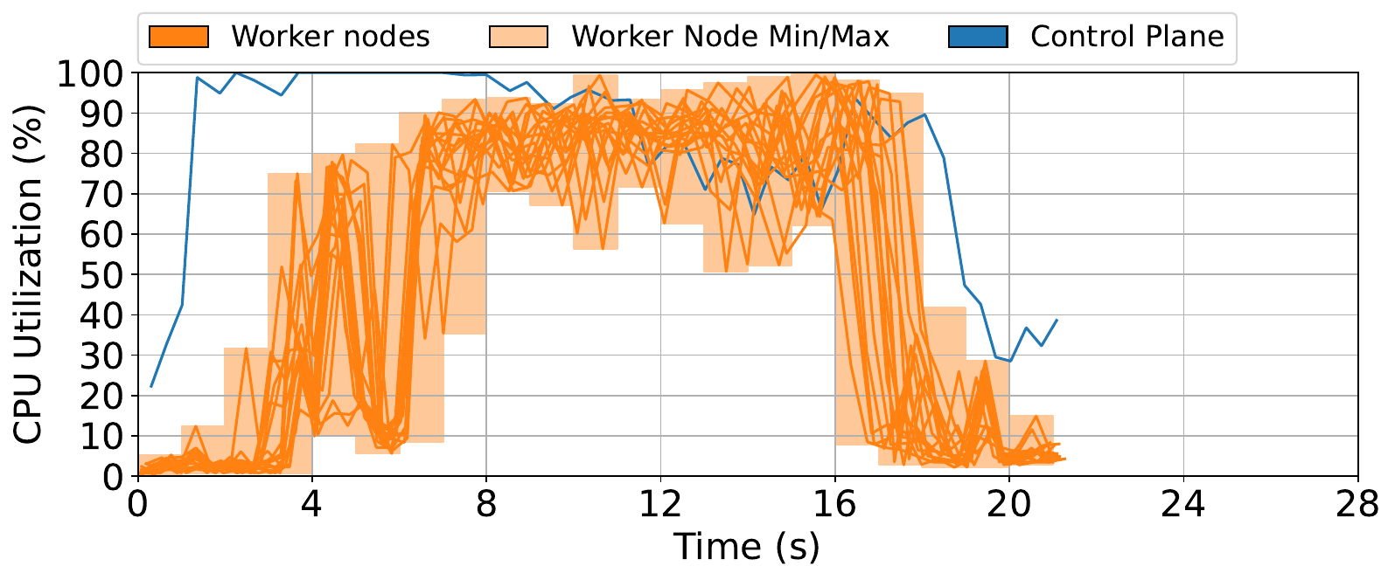
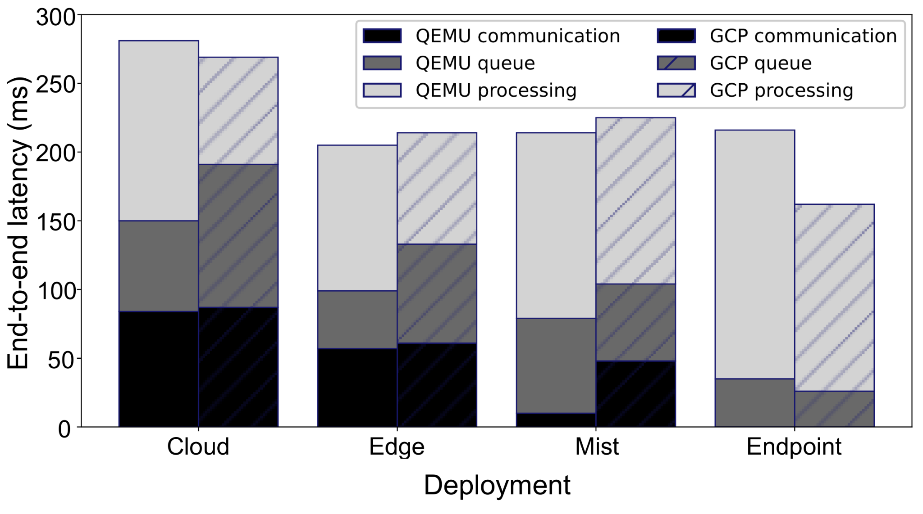
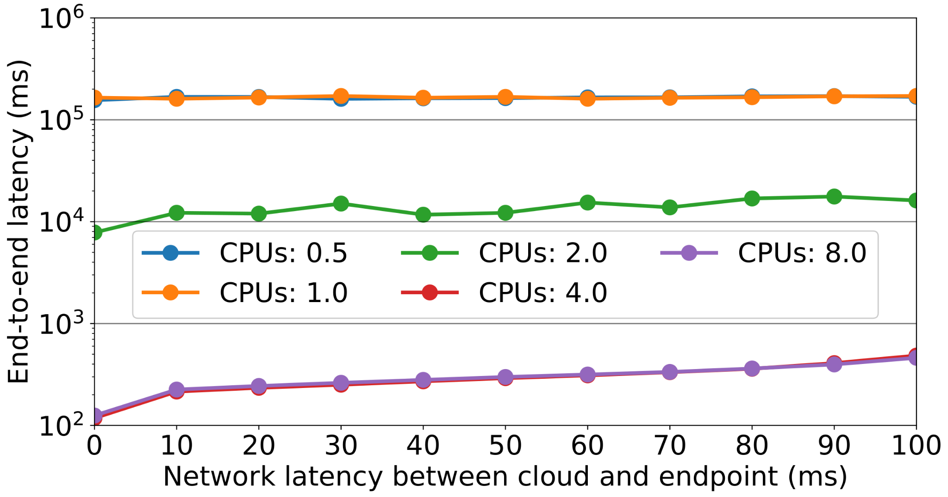
Step 4: Data Gathering & Visualisation
Notes:
Why are containers and resource managers like Kubernetes important
They are used by everyone

Slide 29
Today, You Will
Deploy image classification app with Continuum, on VMs and Kubernetes
Get familiar with Kubernetes
Visualize cloud operations with Prometheus and Grafana
Deploy and instrument apps by hand on Kubernetes
Notes:
What is this difficulty? Difficulty of configuring Kubernetes. Large design space
I will explain the picture later in-depth

Slide 30

Before We Start The Tutorial
We provide access to hardware
Send your PUBLIC SSH key to m.s.jansen@vu.nl (as text in the email and not as attachment)
May need to group up depending on no. participants. If so, only 1 person per group sends SSH key
START HERE:
https://github.com/atlarge-research/continuum/tree/tutorial-2024

